Slide 1
Priority Interrupt Controller 8259

Slide 2
Introduction
Need of Priority Interrupt Controller 8259
Connections of 8259 in 8086 system
Initialization
Interrupt Handling
Notes:
Need: Only NMI,INTR, NMI power failure then only INTR left, insufficient, many sources of hardware interrupts, funneling-many interrupts to INTR
Connections, Initialization,IH - Agenda

Slide 3
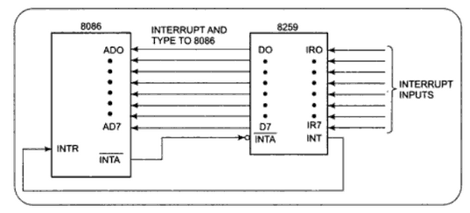
Connections
Working of INTR
When INTR received by 8086
8086-8259: two INTA* pulses
8259-8086: interrupt type
8086: intType * 4
Push flags
Clear IF and TF
Push return address
Get address of ISR from IVT
Load CS:IP

Slide 4
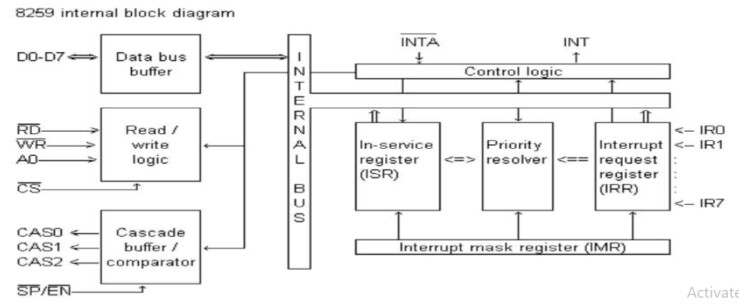
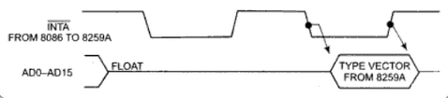
Internal Block Diagram - 8259
D0-D7: CW, SW, IntType
IR0-IR7 --> INT high …
Int. Type
Int. Type = f(IR?,initNo.)
Funneling …
Notes:
DR0 … 3 operations – CW from 8086 to 8259, status word from 8259 to 8086 and intType from 8259 to 8086
IR0 … Any line receiving interrupt causes INT output of 8259 high – connected to INTR 0f 8086 ie 808 interrupted so all the steps of previous slide
Int. Type … 8086 responds with two pulses on INTA* - during the second pulse – 8259 places interrupt type on Data Bus – first pulse details later
Int. Type depends upon IR input and the number that was sent to 8259 at the time of initialization
Funneling … Understand that how funneling is implemented

Slide 5
Internal Block Diagram - 8259
Multiple requests on IRs
Interrupt Mask Register
Interrupt Request Register
In-Service Register
Notes:
When multiple interrupts occur on IR lines of 8259 then priority is used for servicing. IR0 has the highest priority … IR7 the lowest priority .. In that order
Interrupt Mask Register … For every IR input one bt in this register .. We can mask IR input by setting the corresponding bit to 0 in this register
Interrupt Request Register - Every IR has one bit in this register … when interrupt occurs the corresponding bit in this register will be set to 1.
ISRegister … Every IR has one bit in this register … The interrupt that is currently being serviced – its corresponding bit is set

Slide 6
Internal Block Diagram - 8259
Priority Resolver
Notes:
Priority resolver – Suppose IR4 being serviced …and IR2 occurs .. 2nd bit in IRR is set .. IR2 has higher priority than IR4..So 8086 is interrupted..all the steps
Priority Resolver – Suppose IR4 being services .. IR6 occurs .. 6th bit in IRR is set .. After completing the IR4 then IR6 will be serviced

Slide 7
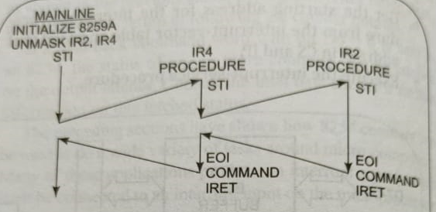
Resolving Priority
STI – in main line code – INTR enabled
STI
EOI

Slide 8
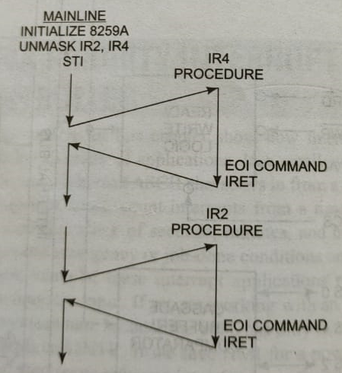
Resolving Priority
IR4 – not using STI – ie INTR not enabled

Slide 9
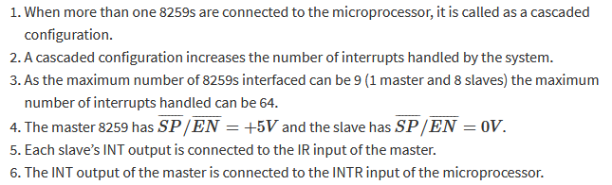
8259 in cascading mode

Slide 10
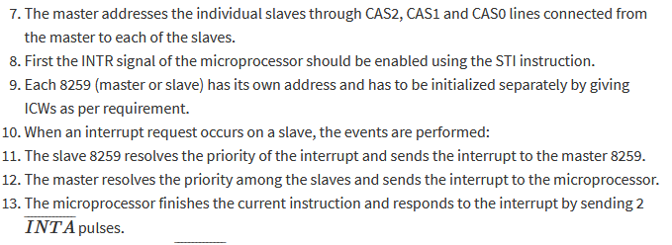
8259 in cascading mode

Slide 11
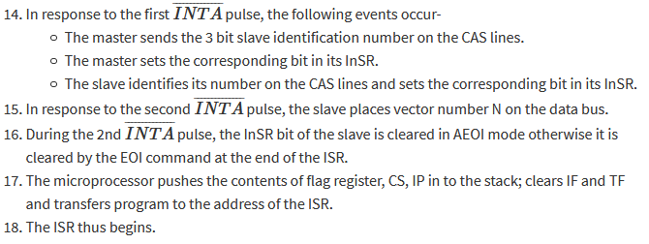
8259 in cascading mode

Slide 12
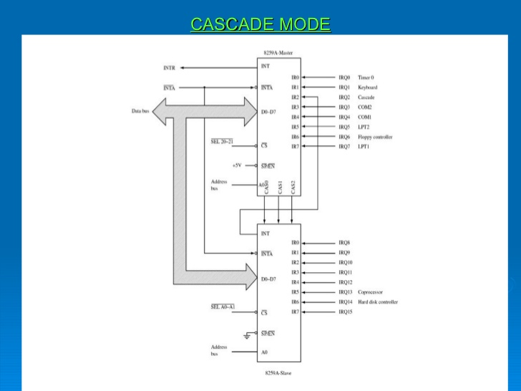
8259 in cascading mode

Slide 13
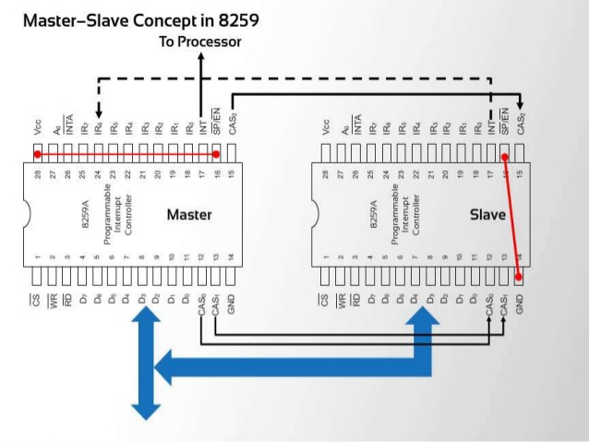
8259 in cascading mode

Slide 14
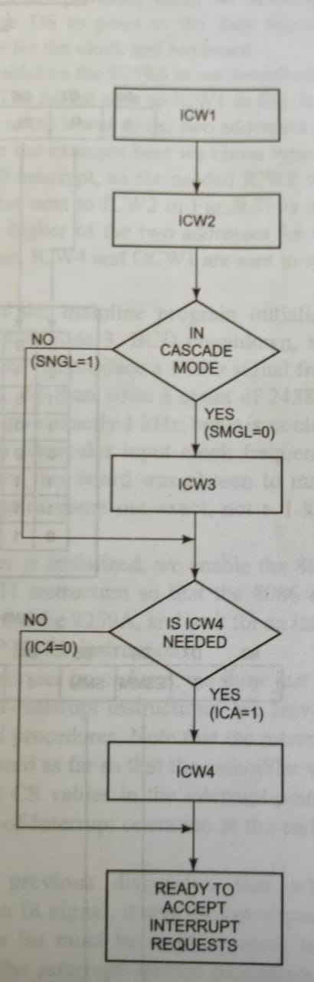
Initializing 8259

Slide 15
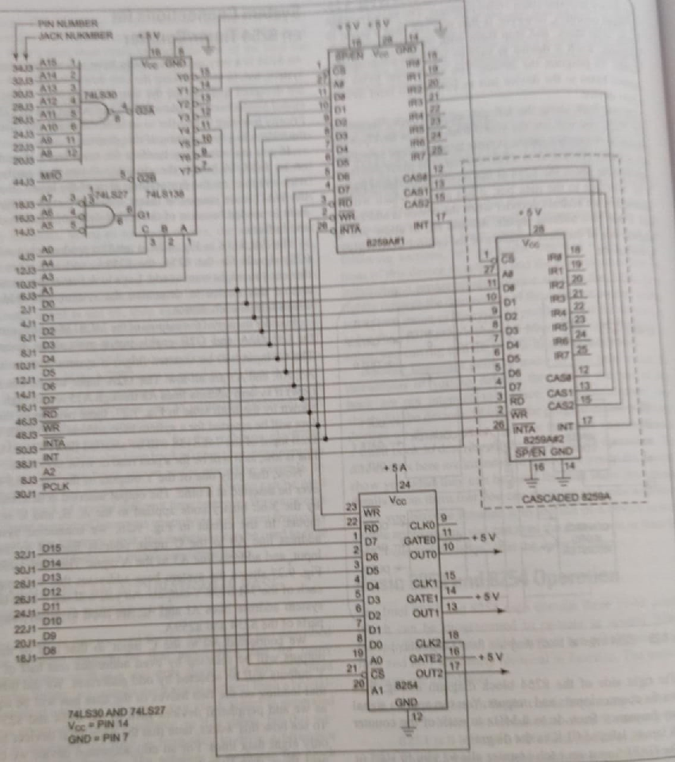
Initializing 8259

Slide 16
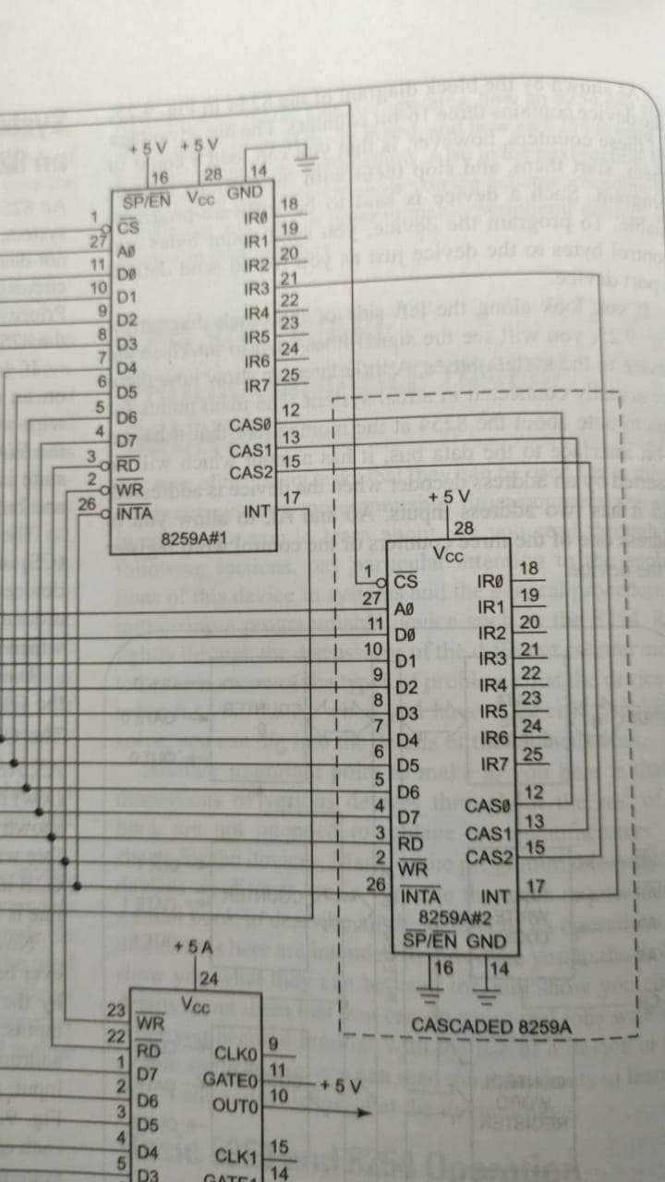
Initializing 8259

Slide 17
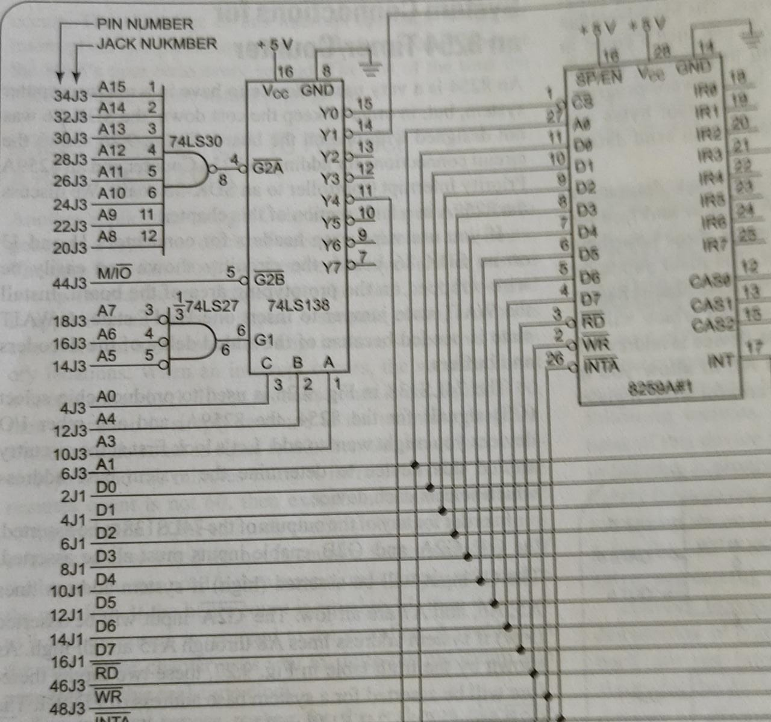
Initializing 8259

Slide 18
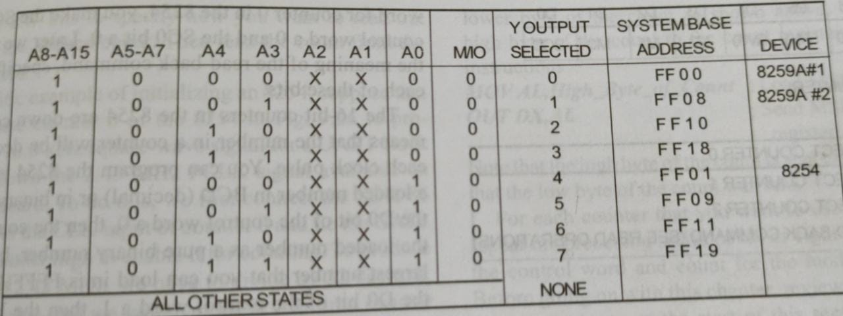
Initializing 8259

Slide 19
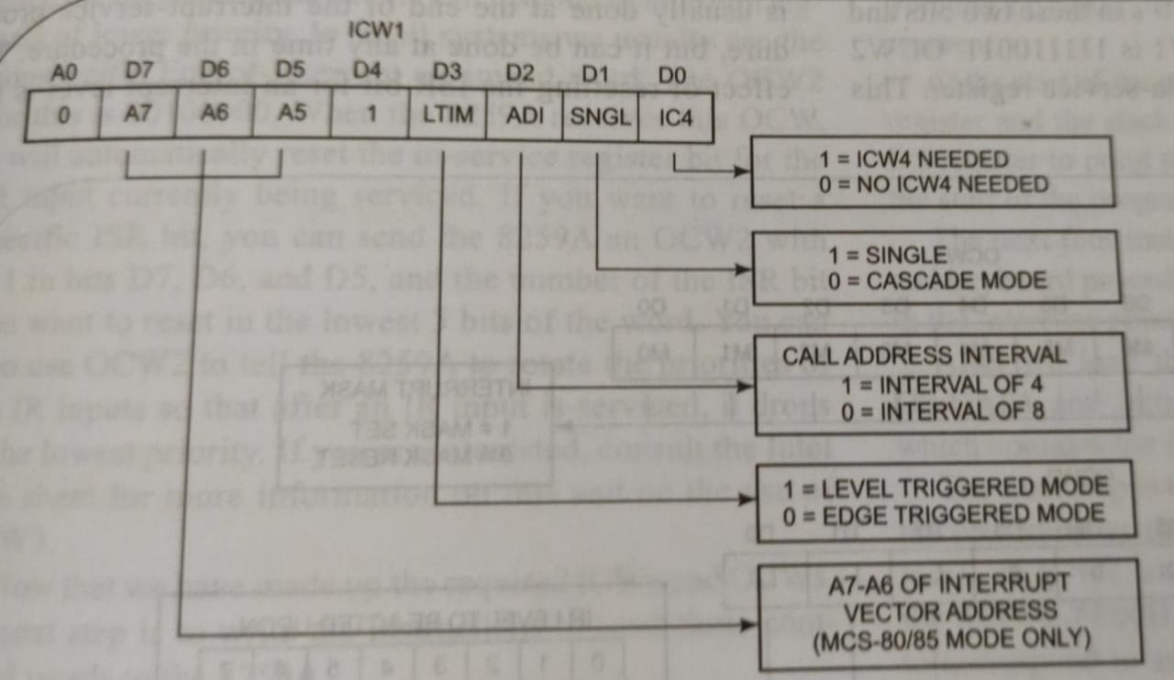
Initializing 8259
To find the system base address
Two addresses for 8259
The address1 is FF00H
The address2 is FF02H
A0:0 for internal address1
A0:1 for internal address2
CW: 00010011

Slide 20
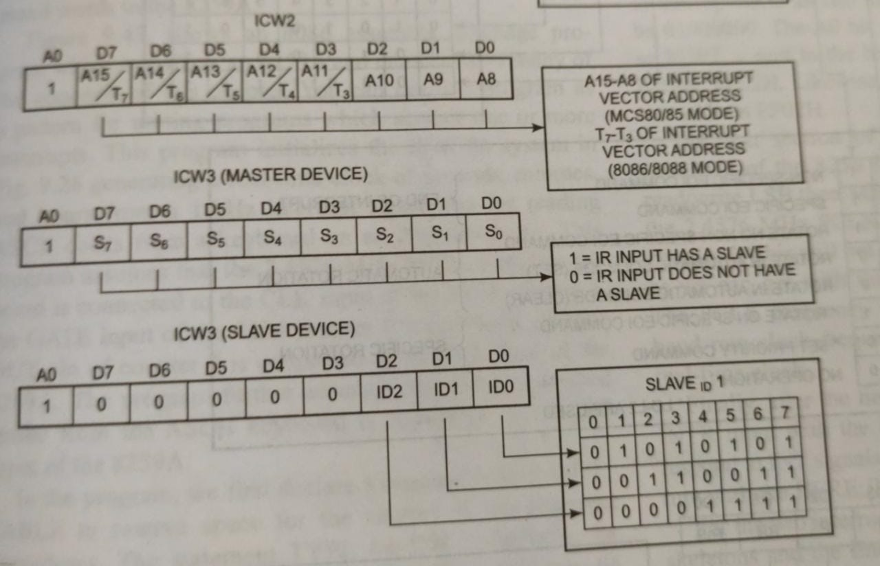
Initializing 8259

Slide 21
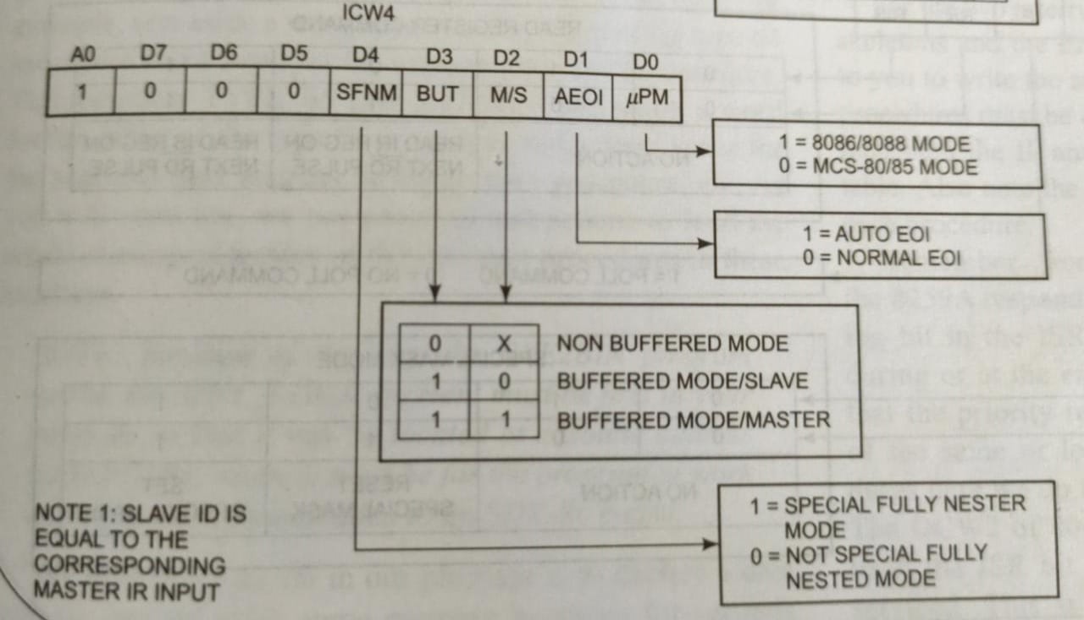
Initializing 8259

Slide 22
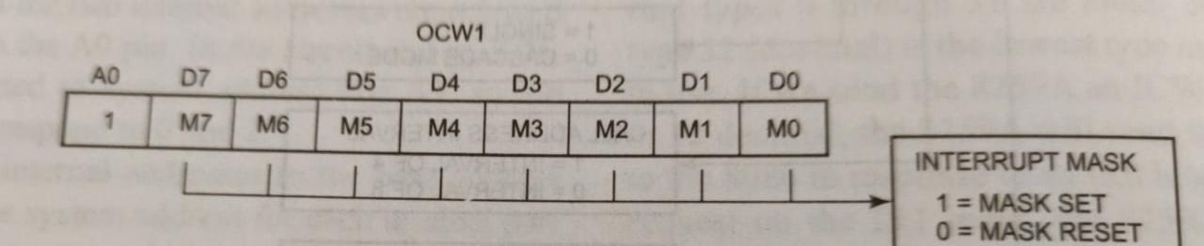
Operational Command Words (OCW)

Slide 23
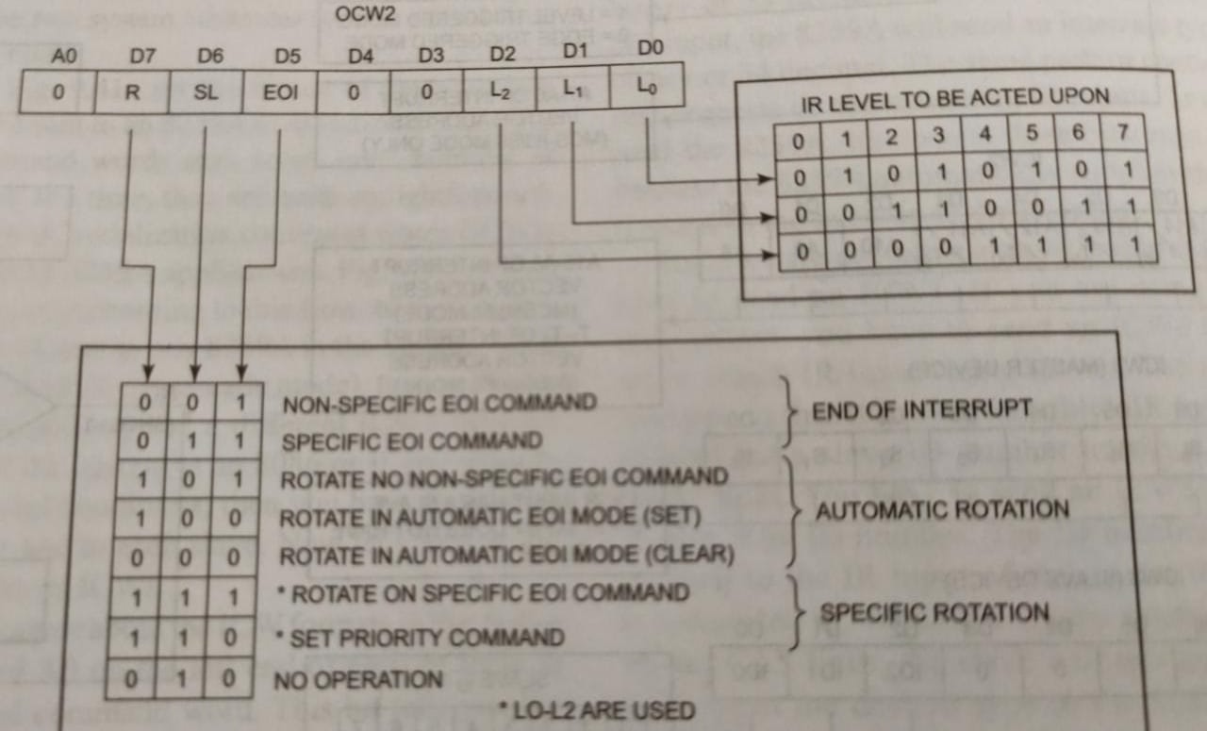
Operational Command Words (OCW)

Slide 24
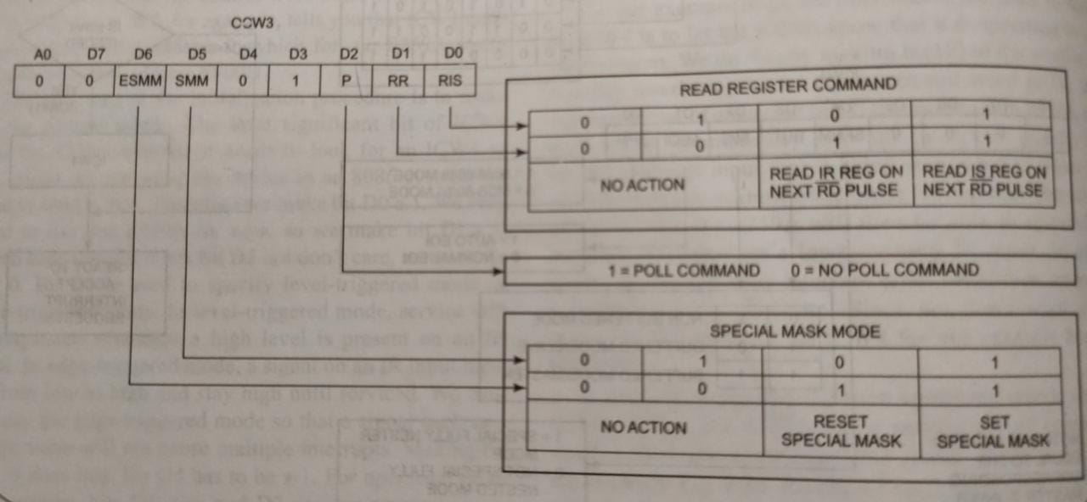
Operational Command Words (OCW)

